Slide 1
CSE 574 Lecture 10: Introduction to Infinite Horizon Problems
Professor: Stephanie Gil
Email: sgil@asu.edu (Office hours M 12-1pm BYENG 386)
TAs: Sushmita Bhattacharya sbhatt55@asu.edu (Office hours M 5-6 BYENG 392)
Weiying Wang wwang239@asu.edu (Office hours Th 2:30-3:30 BYENG 392)

Slide 2
Announcements
HW 3 due this Friday at 5pm
Midterm next week! Wednesday Oct 3 in class
Practice midterm out this week, review session for midterm next Monday Oct 1 in class
Final project proposal due next Friday Oct 5 by 5pm
Changes to next week’s office hours due to midterm
Myself and Sushmita office hours Monday regular time
Weiying office hours will move to Tuesday
I will hold additional office hours next week on Thursday to discuss final project proposals (this is in lieu of my office hours during the following week Monday Oct 8th)

Slide 3
Infinite Horizon Problems
Previous class focused on problems with N stages (finite)
Today we let the number of stages N tend to infinity
Long horizon problems
May have terminal states but where horizon is stochastic
Systems are stationary (i.e. the system equation, cost per stage, and random disturbance statistics do not change from one stage to the next)
We will study three main classes of problems:
Stochastic shortest path problems
Discounted problems with bounded cost per stage
Average cost per stage problems

Slide 4

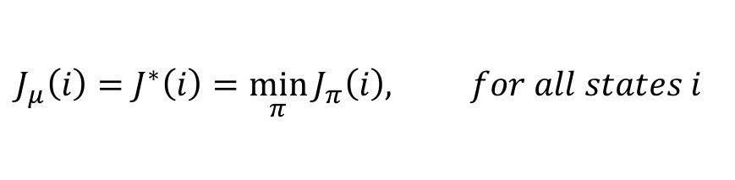
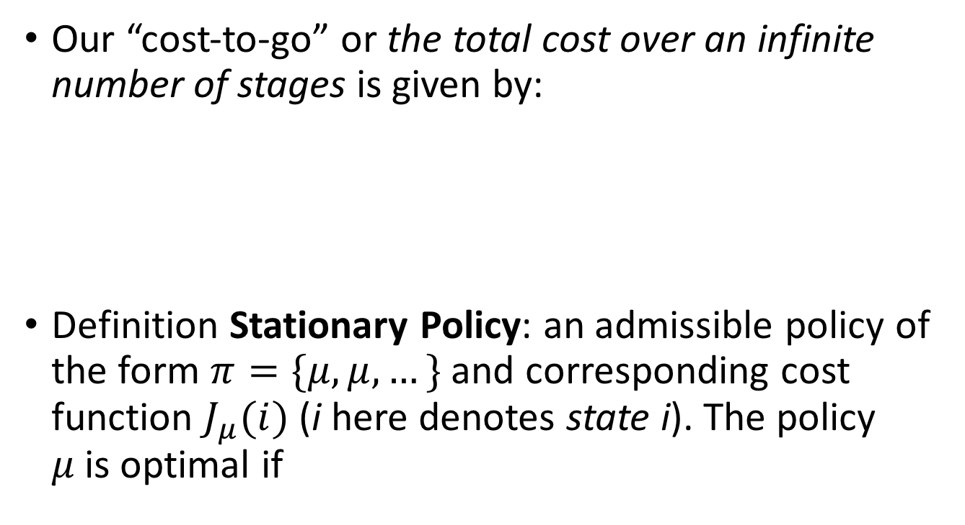
Cost for Infinite Horizon Case
Our “cost-to-go” or the total cost over an infinite number of stages is given by:
Definition Stationary Policy: an admissible policy of the form $π=\{μ,μ,…\}$and corresponding cost function $J_{μ}(i)$(i here denotes state i). The policy $μ$is optimal if
$$J_{π}\left(x_{0}\right)=\lim_{N→∞}{ E}_{{\begin{aligned}W_{k}, \\ k=0,1,…\end{aligned}}_{}}\left\{\sum_{k=0}^{N−1}{α^{k}g(x_{k},μ_{k}\left(x_{k}\right),w_{k})}\right\}⁡$$
$$J_{μ}\left(i\right)=J^{∗}\left(i\right)=\min_{π}{J_{π}\left(i\right), for all states i}⁡$$

Slide 5
Computational Methods
What about general methods for finding J*?
We want to be able to perform value iteration and policy iteration for three classes of problems
Stochastic shortest path
Discounted problems with bounded cost per stage
Average cost per stage problems
These problems have slightly different forms of the iteration algorithms
We have seen this case in class before

Slide 6
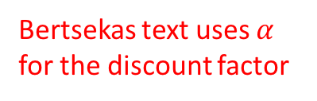

Recall from Lecture 6 on MDPs:
Formulating a finite horizon problem as an infinite horizon problem
Starting from S0 we get the reward sequence +1,+1,+1,0,0,0,…
So now we can write the return of a finite or infinite horizon task as an infinite sum
$G_{t}≜\sum_{k=t+1}^{T}{γ^{k−t−1}R_{k}}$ where $T=∞ or γ=1$
Special terminal state
[Sutton and Barto text section 3.4]
Bertsekas text uses $α$ for the discount factor

Slide 7

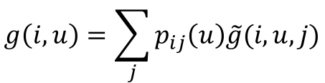

Discounted Problems DP Formulation
Formulation
States are i=1,..,n
Discount factor $α<1$
Control u from state i has a cost $g(i,u)$(except in the terminal state
Value iteration algorithm for discounted problems
Figure 5.4.1 Dynamic Programming and Optimal Control text
$$J_{k+1}\left(i\right)=\min_{u∈U\left(i\right)}\left[g\left(i,u\right)+α\sum_{j=1}^{n}{p_{ij}\left(u\right)J_{k}(j)}\right], i=1,…,n$$
$$g\left(i,u\right)=\sum_{j}{p_{ij}\left(u\right)\tilde{g}(i,u,j)}$$
Cost of using u at state i and moving to state j

Slide 8
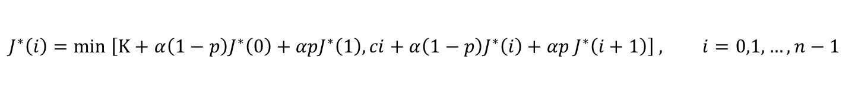

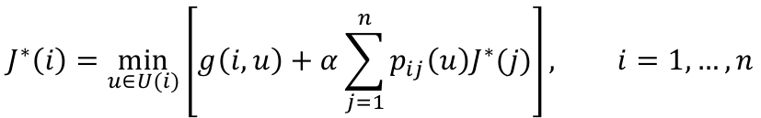
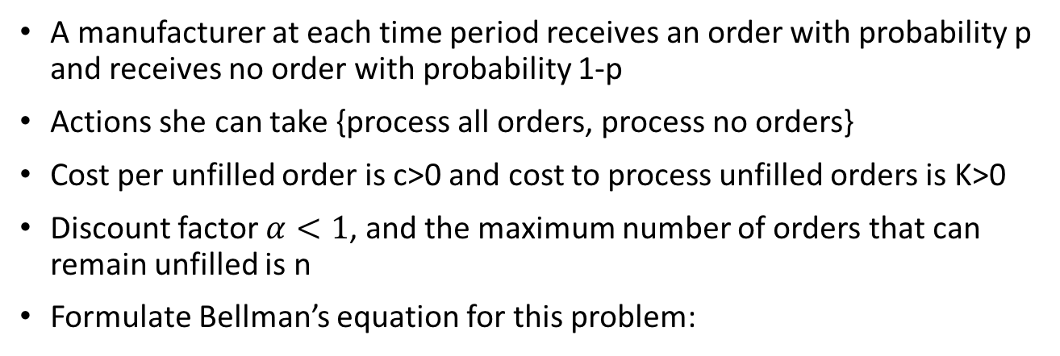
Example: Processing Orders
A manufacturer at each time period receives an order with probability p and receives no order with probability 1-p
Actions she can take {process all orders, process no orders}
Cost per unfilled order is c>0 and cost to process unfilled orders is K>0
Discount factor $α<1$, and the maximum number of orders that can remain unfilled is n
Formulate Bellman’s equation for this problem:
$$J^{∗}\left(i\right)=\min_{u∈U(i)}\left[g\left(i,u\right)+α\sum_{j=1}^{n}{p_{ij}\left(u\right)J^{∗}(j)}\right], i=1,…,n$$
$$J^{∗}\left(i\right)=min \left[K+α\left(1−p\right)J^{∗}\left(0\right)+αpJ^{∗}\left(1\right), ci+α\left(1−p\right)J^{∗}\left(i\right)+αp J^{∗}\left(i+1\right)\right] , i=0,1,…,n−1$$
Fill orders
Don’t fill orders
$$J^{∗}\left(n\right)=K+α\left(1−p\right)J^{∗}\left(0\right)+αpJ^{∗}(1)$$
Must fill orders once we hit the maximum number of orders n

Slide 9
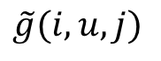
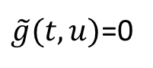
Stochastic Shortest Path Problems
Goal: reach the termination state with minimum expected cost
$$\tilde{g}(i,u,j)$$
States
State costs
Transition probabilities
Terminal state
$\tilde{g}(t,u)$=0
Figure 5.2.1 Dynamic Programming and Optimal Control text

Slide 10



How to Reason About Infinite Sum?
Here we don’t have discounting … how to reason about$k→∞$?
$$α=1$$
$$J_{k+1}\left(i\right)=\min_{u∈U\left(i\right)}\left[g\left(i,u\right)+α\sum_{j=1}^{n}{p_{ij}\left(u\right)J_{k}(j)}\right], i=1,…,n$$

Slide 11
Termination?
We must make the following assumption that eventually the terminal state will be reached
Pg 239 of the Dynamic Programming and Optimal Control text

Slide 12
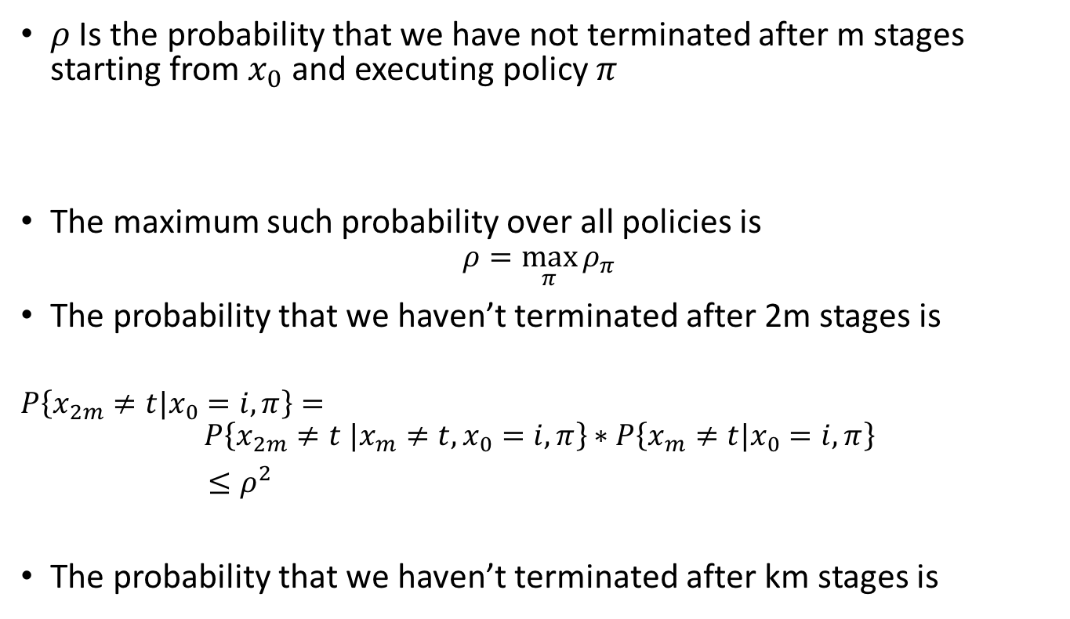
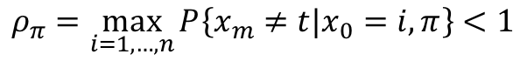
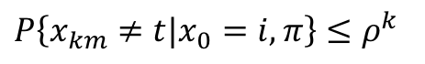
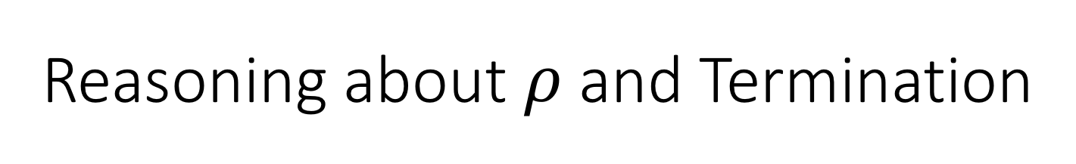
Reasoning about $ρ$and Termination
$ρ$ Is the probability that we have not terminated after m stages starting from $x_{0}$ and executing policy $π$
The maximum such probability over all policies is
$$ρ=\max_{π}{ρ_{π}}$$
The probability that we haven’t terminated after 2m stages is
$$P\left\{x_{2m}≠t|x_{0}=i,π\right\}=$$
$$P\left\{x_{2m}≠t |x_{m}≠t,x_{0}=i,π\right\}∗P\left\{x_{m}≠t|x_{0}=i,π\right\}$$
$≤ρ^{2}$
The probability that we haven’t terminated after km stages is
$$ρ_{π}=\max_{i=1,…,n}{P\left\{x_{m}≠t|x_{0}=i,π\right\}<1}$$
$$P\left\{x_{km}≠t|x_{0}=i,π\right\}≤ρ^{k}$$
Geometric term is back!

Slide 13

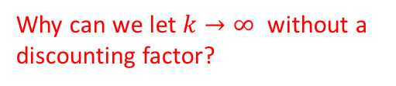
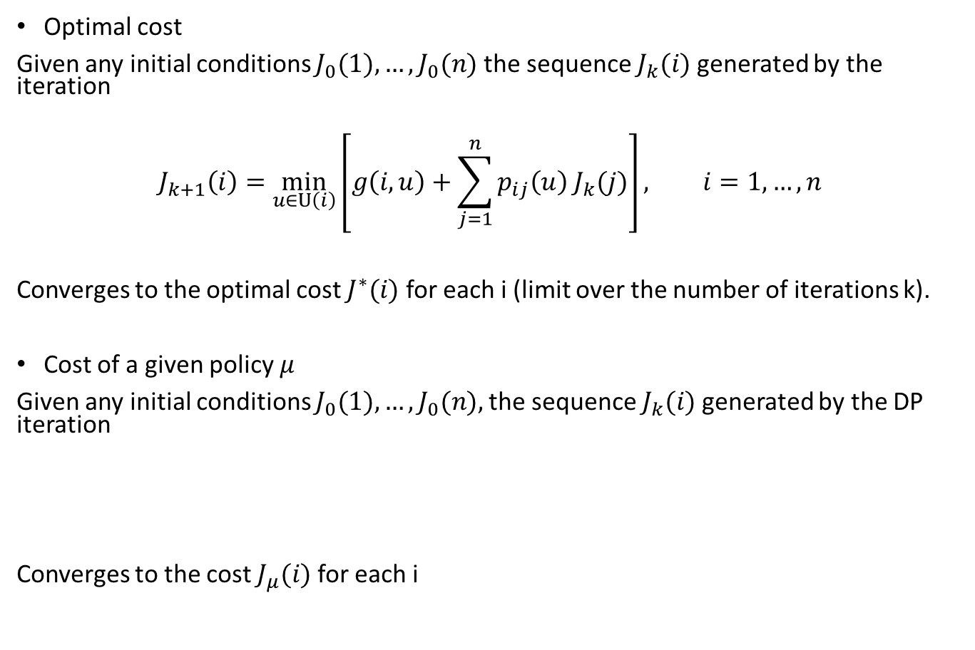
Stochastic Shortest Path Problem
[Refer to Proposition 5.2.1 in the DP text]
Optimal cost
Given any initial conditions $J_{0}(1),…,J_{0}(n)$the sequence $J_{k}(i)$generated by the iteration
$$J_{k+1}\left(i\right)=\min_{u∈U\left(i\right)}\left[g\left(i,u\right)+\sum_{j=1}^{n}{p_{ij}\left(u\right){ J}_{k}(j)}\right], i=1,…,n$$
Converges to the optimal cost $J^{∗}(i)$for each i (limit over the number of iterations k).
Cost of a given policy$μ$
Given any initial conditions $J_{0}(1),…,J_{0}(n),$the sequence $J_{k}(i)$generated by the DP iteration
Converges to the cost $J_{μ}(i)$for each i
Why can we let $k→∞$ without a discounting factor?
$$J_{k+1}\left(i\right)=g\left(i,μ(i)\right)+\sum_{j=1}^{n}{p_{ij}\left(μ\left(i\right)\right){ J}_{k}\left(j\right), }. i=1,…,n$$

Slide 14
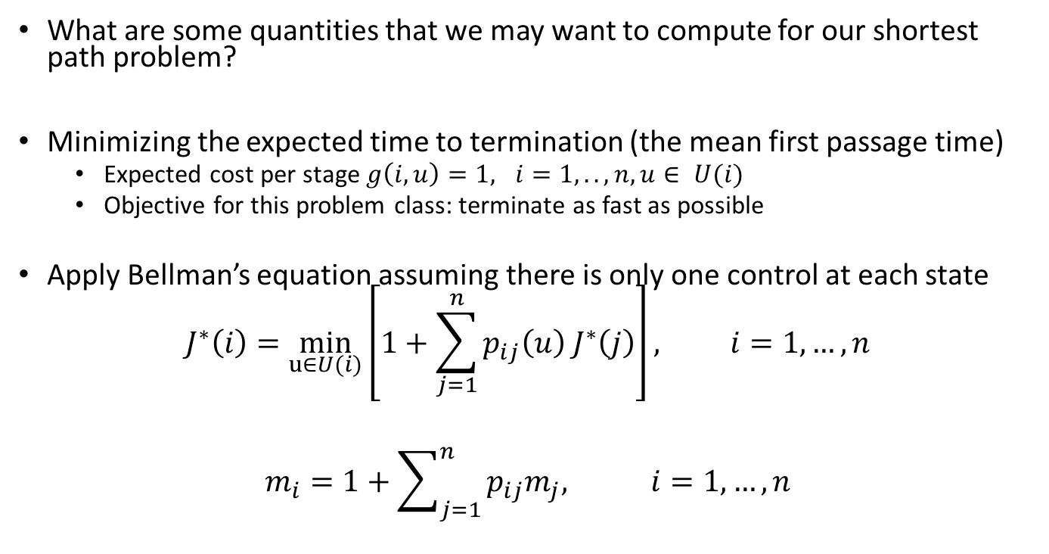
Mean First Passage Time
What are some quantities that we may want to compute for our shortest path problem?
Minimizing the expected time to termination (the mean first passage time)
Expected cost per stage $g\left(i,u\right)=1, i=1,..,n, u∈ U(i)$
Objective for this problem class: terminate as fast as possible
Apply Bellman’s equation assuming there is only one control at each state
$$J^{∗}\left(i\right)=\min_{u∈U(i)}\left[1+\sum_{j=1}^{n}{p_{ij}\left(u\right){ J}^{∗}\left(j\right)}\right], i=1,…,n$$
$$m_{i}=1+\sum_{j=1}^{n}{p_{ij}m_{j}, i=1,…,n}$$
Mean passage time for node i
Mean passage time for node j

Slide 15
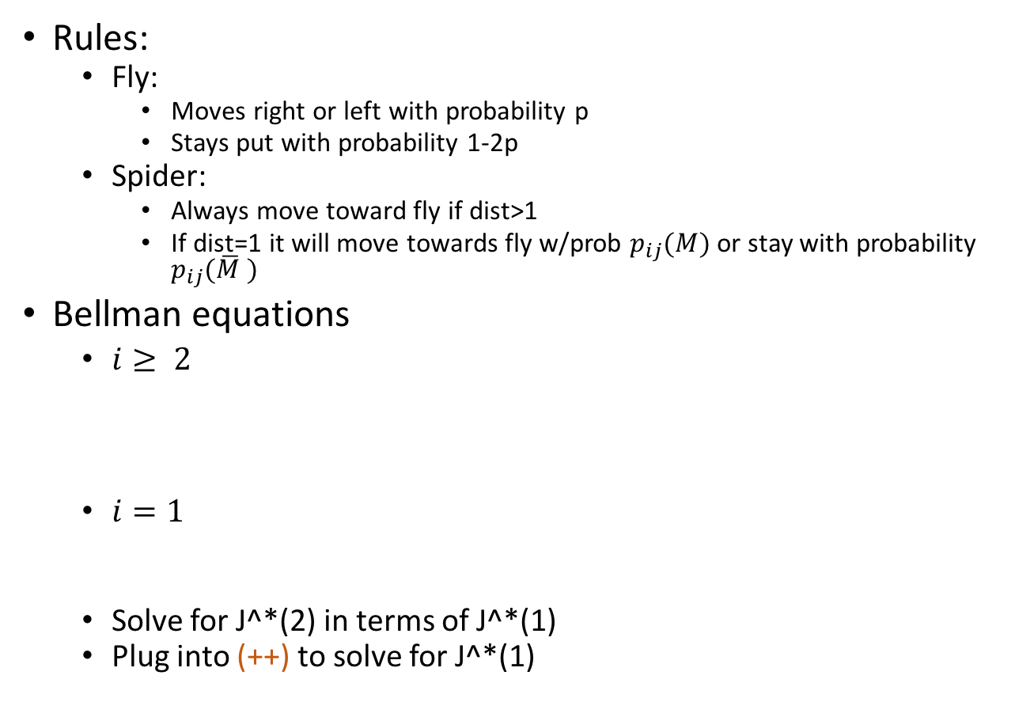
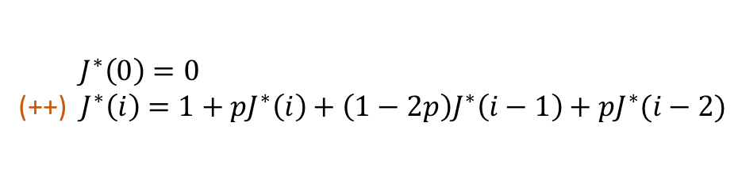
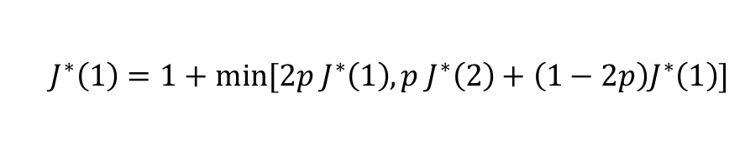
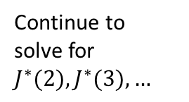

Example: Fly and the Spider
Example 5.2.2 in the Bertsekas text
Rules:
Fly:
Moves right or left with probability p
Stays put with probability 1-2p
Spider:
Always move toward fly if dist>1
If dist=1 it will move towards fly w/prob $p_{ij}(M)$or stay with probability $p_{ij}(\overline{M} )$
Bellman equations
$i≥ 2$
$i=1$
Solve for J^*(2) in terms of J^*(1)
Plug into (++) to solve for J^*(1)
${ J}^{∗}\left(0\right)=0$
(++)${ J}^{∗}\left(i\right)=1+pJ^{∗}\left(i\right)+\left(1−2p\right)J^{∗}\left(i−1\right)+pJ^{∗}(i−2)$
$J^{∗}\left(1\right)=1+min⁡[2p J^{∗}\left(1\right),p{ J}^{∗}\left(2\right)+\left(1−2p\right)J^{∗}\left(1\right)]$
$$J^{∗}(1)=\left\{{\frac{1}{1−2p} if p≤1/3 \atop \frac{1}{p} if p≥1/3}\right.$$
Continue to solve for $J^{∗}(2),J^{∗}(3),…$

Slide 16
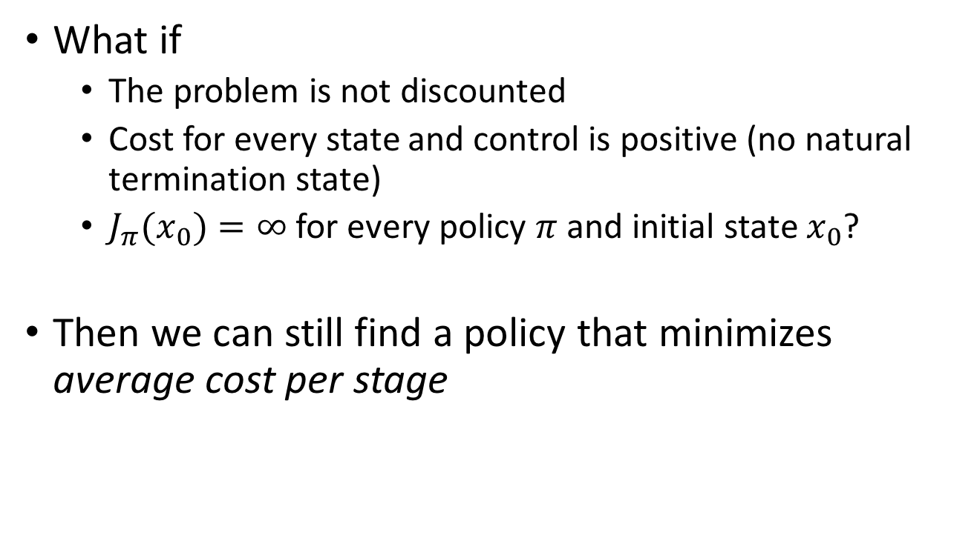

Average Cost Per Stage Problems
What if
The problem is not discounted
Cost for every state and control is positive (no natural termination state)
$J_{π}(x_{0})=∞$for every policy $π$and initial state $x_{0}$?
Then we can still find a policy that minimizes average cost per stage
$$J_{π}\left(i\right)=\lim_{N→∞}{\frac{1}{N}E_{\begin{aligned}w_{k} \\ k=0,1,..\end{aligned}}\left\{\sum_{k=0}^{N−1}{g\left(x_{k},μ_{k}\left(x_{k}\right),w_{k}\right)|x_{0}=i}\right\}}$$

Slide 17

Bellman’s Equation for Average Cost per Stage Problems
Idea: recast as a stochastic shortest path problem
The topic of average cost per stage problems will not be covered further in class or on exams. Interested students should read the Dynamic Programming and Optimal Control text Section 5.5
$$λ^{∗}+h^{∗}\left(i\right)=\min_{u∈U(i)}\left[g\left(i,u\right)+\sum_{j=1}^{n}{p_{ij}\left(u\right)h^{∗}(j)}\right],i=1,…,n$$
Optimal average cost is the same for all states

Slide 18
Next Time…
HW 3 is posted (due Sept 28th at 5pm)
Minimax control and augmented formulations
Readings will be posted on Blackboard → special access made possible by Prof. Dimitri Bertsekas to his Dynamic Programming and Optimal Control text!

